Slide 1
Making Conditional Cash Transfer Programs More Efficient: Designing for Maximum Effect of the conditionality
Alain de Janvry and Elisabeth Sadoulet
Presented by Rui Su

Slide 2
Introduction
Conditional cash transfer
To induce investment of children’s human capital
Require meeting the school attendance and health practice requirement
Presuming social service (income effect) do not work---into price effect

Slide 3
Introduction
Innovation of organizing poverty-reduction program
Several well-known programs
Large, expensive, but few programs have been evaluated
Alternative way
Better targeting of qualifying poor households
Better calibration of the levels of cash transfer could help raise program efficiency
Progresa: now is called Oportunidades, positive

Slide 4
Introduction
Dual objective:
Immediate poverty reduction through transfers
Accurately target to poor HHs-difficult(not addressed here)
Long-term poverty reduction---human capital
Accurate selecting : minimize efficiency leakage
To children who will attend school only because of transfer
To meet the opportunity cost of the change in behavior
Definition and rules would be easy and transparent
Tradeoff between efficiency and inequity (Progresa, 29-44 percent)

Slide 5
I. The Efficiency Issue in Progresa
Introduction of Progresa
Three components: education(children), healthcare(family), and nutrition(wo&c)
Scale: 2.6 billion families, $950 million, while 44 percent of it for education transfer, which benefit 2.4 billion children.
To be more efficiency---to other conditional transfer program where has limited budget

Slide 6
I. The Efficiency Issue in Progresa
Sample selection
506 marginal communities containing 24,000 households and 17,000 children eligible
Start a year before and every 6 month in 3 years.
320 random selected treatment communities and 186 control communities
Restricted to children in school in October 1997
Further restricted to 2242 children

Slide 7
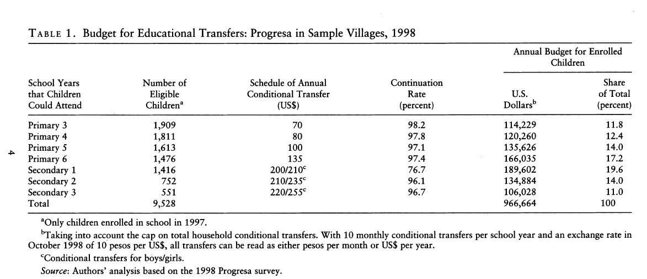
I. The Efficiency Issue in Progresa
Focusing on Entry into Secondary School
55.4

Slide 8
I. The Efficiency Issue in Progresa
Increase continuation rate at all grades
Already very high(Figure 1) only one percent
There should be other program to help the 3-4 percent and eliminating all transfer to primary school(55.4%)
So the analysis here only for secondary school
Transfers increase for higher grades(girls)
Transfer cap---to not induce fertility response
13.4 percent of eligible children
Scaling down all the education transfer subject to the cap
The budget would be 17% higher without cap

Slide 9
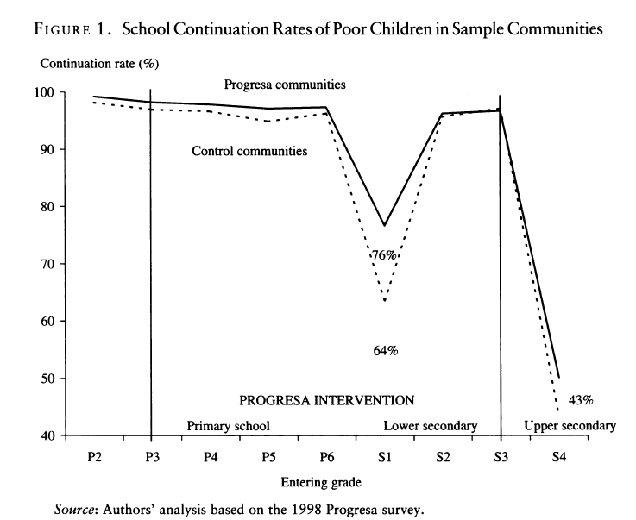
I. The Efficiency Issue in Progresa

Slide 10
I. The Efficiency Issue in Progresa
The conditional transfers offered to children in second and third years are not questioned
Part of expected benefit
High continuation rates even without subsidy, while the induced one would not continue; the number for second and third year is lower than the first because the program started in 1997

Slide 11
I. The Efficiency Issue in Progresa
The efficiency of Progresa’s Education Transfers
Two sources of inefficiency: in primary school; the children that would enter secondary school without transfer(64%)
64-76---(1) lower cost, same effect?
(2) the left 24, how would they join in
(3) if founded, offer for them increases?

Slide 12
I. The Efficiency Issue in Progresa
Opportunity cost --- work wages, but 30% children work, and they drop out for several other reasons, eg. do not like school or school is too far away---hard to calculate
The cap on total conditional transfer to a household is used as the marginal response to varying conditional transfer amounts

Slide 13


II. A Model of Optimal Cash Transfer
P(X,T)---P of characteristics X, eligible for a conditional transfer T will enroll in school
IЄ[0,1]---eligibility
f(x)--- density function of x
To maximize the gain in enrollment over the population
Subject to a budget constraint
where B is the budget available for the program

Slide 14

II. A Model of Optimal Cash Transfer
The first order condition for the optimal conditional transfer is that, for any eligible child(I=1),
Where and is the Lagrange multiplier associated with the budget constraint
The cost of transfers:
And the marginal equivalent of the decomposition of the cost of transfer:
Optimal eligibility
The optimal allocation of a budget B is the solution to the system of equation (2)(3)(4)

Slide 15


II. A Model of Optimal Cash Transfer
Linear probability model :the conditional expectation of the enrollment probability is
From (3) and (5)
The expression shows that both eligibility and the optimal conditional transfer for any given child are function of the ratio
Too complex to use in reality. But still useful. X is observable
Back

Slide 16


II. A Model of Optimal Cash Transfer
An Implementable Conditional Cash Transfer Program
Simple and transparent---Progresa: grade and gender ---simplify (7) to a linear index on the basis of a few characteristics Z of the children.
Satisfy (1) and (2), and using simple linear formulas
where Z is the subset of characteristics and need to be determined
Optimal eligibility:
a is solution to the maximization of a quadratic function:
where E is the set of eligible children, is the marginal effect of the conditional transfer on child’s school enrollment . P without t
back

Slide 17
II. A Model of Optimal Cash Transfer
Za determines not only eligibility but also the conditional transfer amount
Empirical question:
Whether the use of this simple scoring schedule is close enough to the optimal condition cash transfer schedule
What type I and type II errors are made in this implementation.

Slide 18
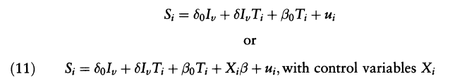
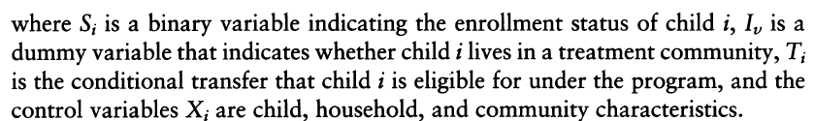
III. Predicting Enrollment
The empirical equivalent to equation (6) is written as (the linear)
where is a binary variable indication the enrollment status of child i
The increasing in probability that qualifying poor children (T2C1)
Marginal effect of the conditional transfer: high, $100 +
Adding child, household, and community controls-T3
Heterogeneity of impact across categories : gender different from above; All of them have large impact on enrollment
Predictive model to evaluate the impact of targeting on enrollment

Slide 19
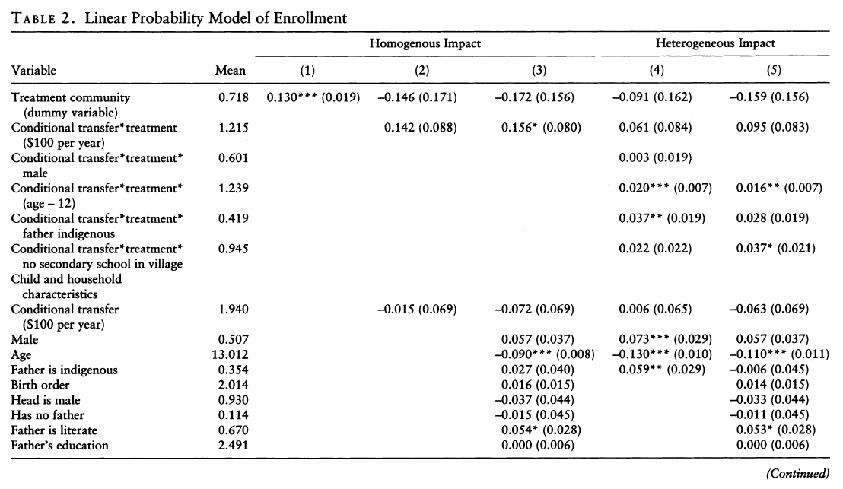
III. Predicting Enrollment
Back

Slide 20
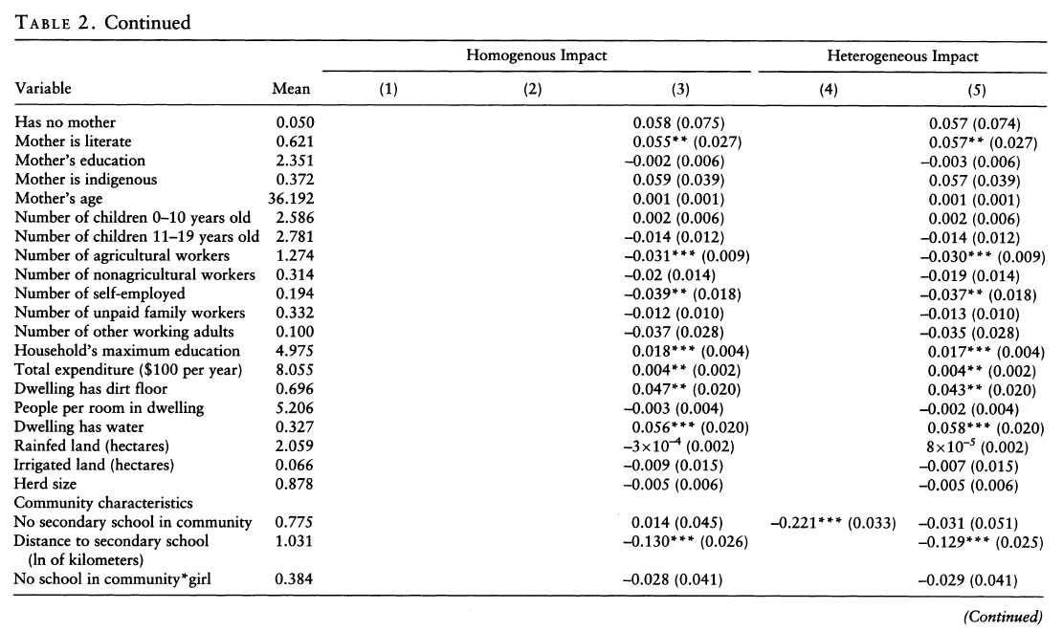
III. Predicting Enrollment

Slide 21
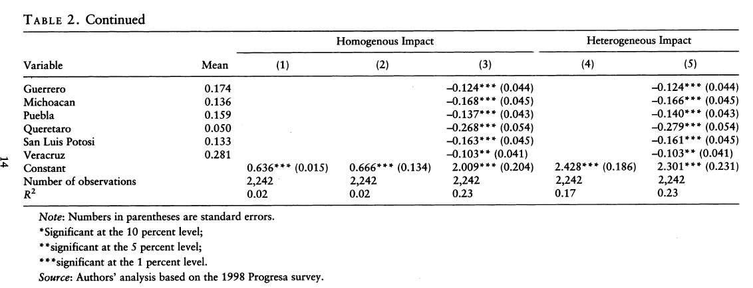
III. Predicting Enrollment

Slide 22
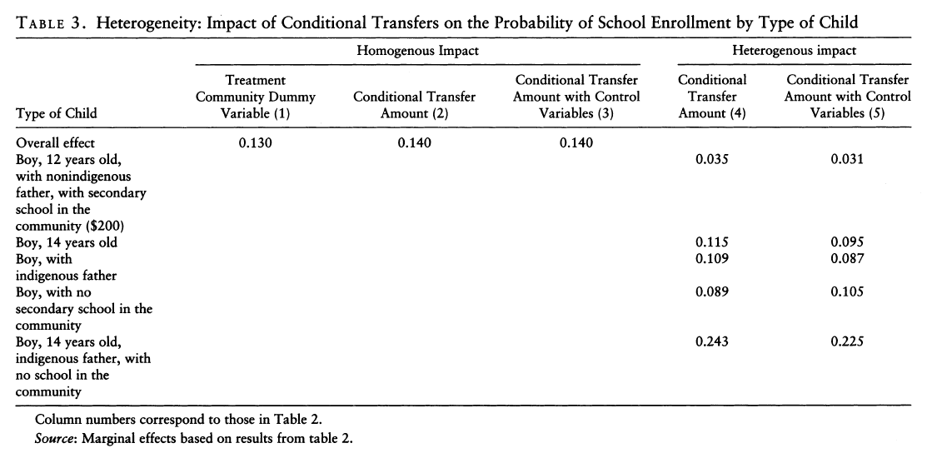
III. Predicting Enrollment
The controls are orthogonal to the treatment

Slide 23
III. Predicting Enrollment
These large differences suggest that there can be efficiency gains by using some of these dimensions of heterogeneity to target conditional transfer---Progresa: gender
The children get less due to the cap: still have the same result. Parameters are neither individually nor globally significantly different. The orthogonally is verified. So the model can be used to predict behavior in the absence of conditional cash transfer program.

Slide 24
IV. Comparing Conditional Cash Transfer Schedules
Three targeting and calibration schedules in Table 4
Same total budget
Upper: predicted enrollment without transfer
Lower: some aggregate targeting and cost outcomes for the different schedules. It’s also represented in Figure 2
The distance from the diagonal to each curve represents the gain in enrollment from the program with the corresponding schedule

Slide 25
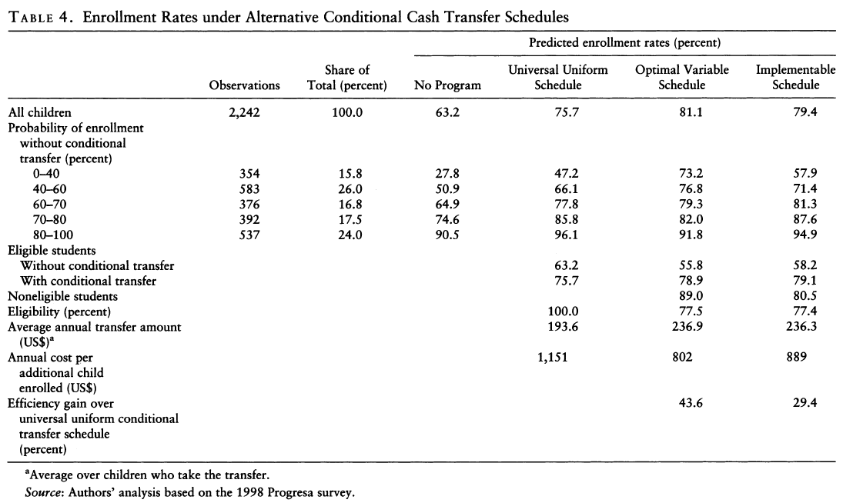
IV. Comparing Conditional Cash Transfer Schedules
19.4
5.6
f3
Because many children would attend even without transfer(f2)
Back

Slide 26
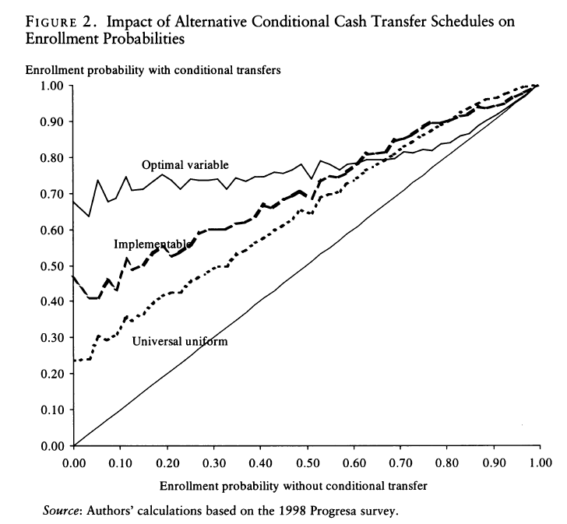
IV. Comparing Conditional Cash Transfer Schedules
Back opti

Slide 27
IV. Comparing Conditional Cash Transfer Schedules
Emulation Progresa: A Universal Uniform Conditional Cash Transfer Program
Enrollment with universal conditional transfer↑
Figure 2: the gains due to the program are largest for children with low probability of enrollment
Gains a progressive even with a uniform program
How to have a better result?

Slide 28
IV. Comparing Conditional Cash Transfer Schedules
An Optimal Variable Conditional Cash Transfer Program
Defined by equation(7), and estimated values in table2 column (5) , which based on characteristic X and the transfer would vary
Compared with others in Table 4 and Figure 2
Figure 3: eligible---64%↑, noneligible focused on lower probability, however, most are in 48%-80%

Slide 29
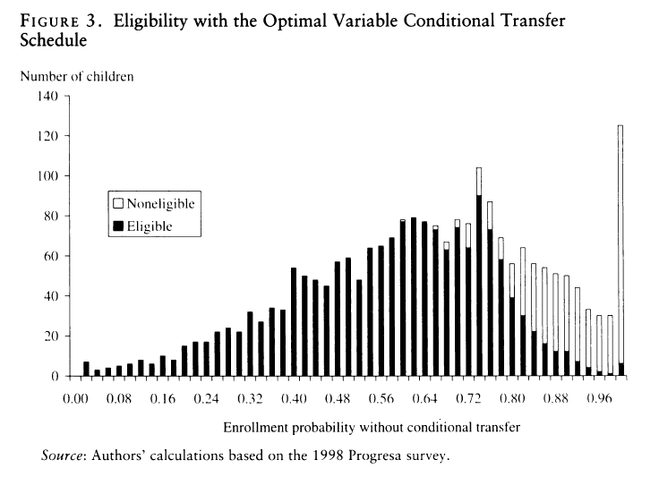
IV. Comparing Conditional Cash Transfer Schedules

Slide 30
IV. Comparing Conditional Cash Transfer Schedules
An Implementable Conditional Cash Transfer Program
A set of variables Z, the implementable schedule is the solution of equation (9)(10)
Efficiency: important characteristic, sensitive to the enrollment, legally and politically acceptable
Base model: several strong variables except age(perverse behavior)
Results are reported in Table 5

Slide 31
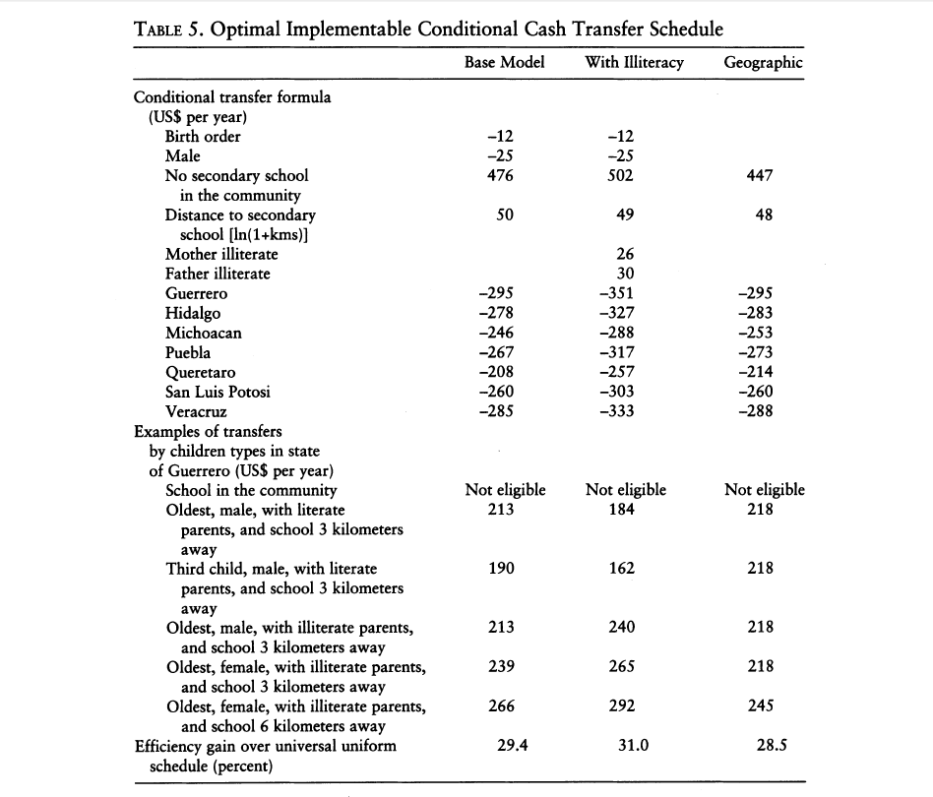
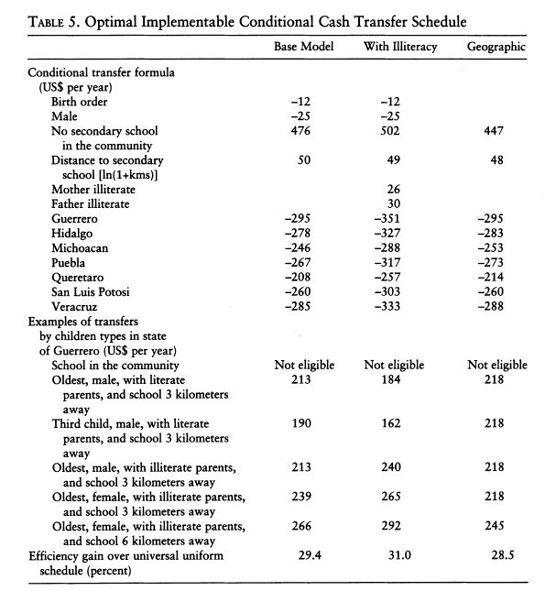
Variation across state

Slide 32
IV. Comparing Conditional Cash Transfer Schedules
This conditional transfer schedule results in an efficiency loss relative to the optimal variable schedule
The cost is paid for simplicity and transparency
Type I and Type II error (not proved) and make the total do not change so much(Table 4)

Slide 33
IV. Comparing Conditional Cash Transfer Schedules
Alternative implementable---adding mother’s and father’s literacy status---raises the efficiency(Table 5)
At community level---The transportation would be redesigned and there would be more school
So, even the system is transparent and easily verifiable, it still feasible and could ensure large efficiency gains

Slide 34
IV. Comparing Conditional Cash Transfer Schedules
Comparing Direct Costs and Efficiency Leakage under the Three Schedules
Key: the magnitude of the transfers that to go children who would go to school without transfer
Universal uniform: quite high ---figure 4
Optimal variable : lower (target on children with low probability) but still high---figure 5√
Implementable: no picture, has a leakage of 72.5
However, ov is too complex and face secrecy; im is still better than uu

Slide 35
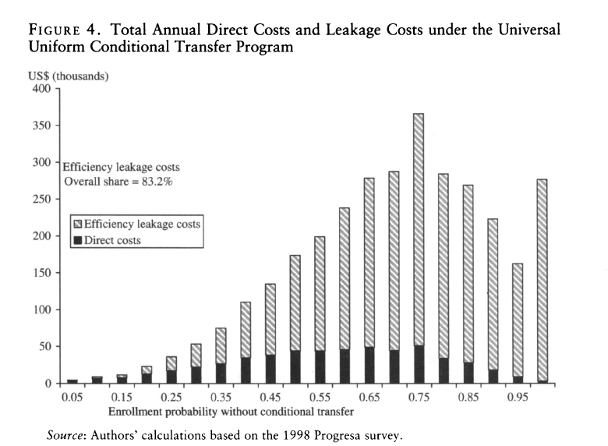
IV. Comparing Conditional Cash Transfer Schedules

Slide 36
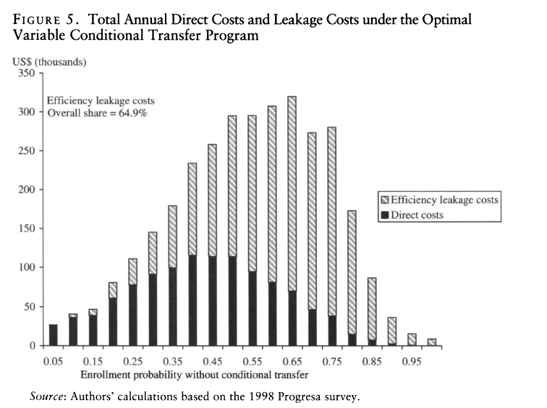
IV. Comparing Conditional Cash Transfer Schedules

Slide 37
V. Efficient Conditional Cash Transfer Programs and Equity
Are efficiency gains in enrollment achieved at an equity cost? No---restricted to the poor
The Progresa transfers themselves were not efficient in reducing poverty or inequality
Progresa welfare index---Progresa UU upward trend: because of the low uptake rate in low welfare class
OV √ IM OK

Slide 38
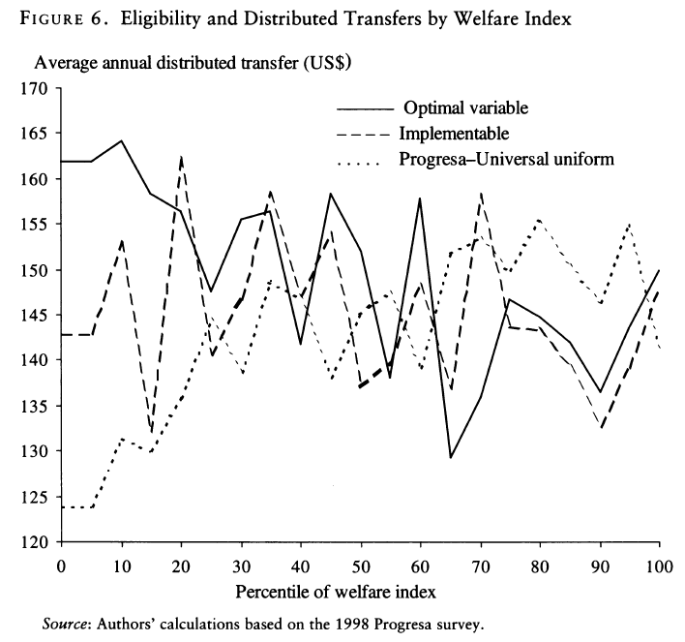

Slide 39
VI. Conclusion
Question: whether efficiency gains can be achieved in conditional cash transfer programs by improving targeting among poor households and better calibrating conditional transfers
Objective: maximize the impact of the condition imposed on the transfer
Sample: data from Progresa

Slide 40
VI. Conclusion
Target: enrollment with transfer—need character X
Empirical: three alternative targeting and calibration schedules
Result: OV>IM>UU
Equity: not achieved
Conclusion: IM should be used broadly

